Slide 1
CPU Scheduling RR

Slide 2
Round Robin (RR) Scheduling
Round Robin is the preemptive process scheduling algorithm.
Each process is provided a fix time to execute, it is called a quantum.
Once a process is executed for a given time period, it is preempted and other process executes for a given time period.
Context switching is used to save states of preempted processes

Slide 3
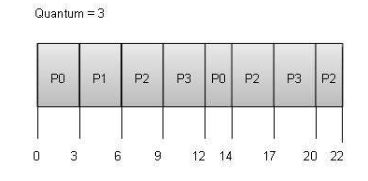
Round Robin Example
Process Arrival Time Burst Time
P0 0 5
P1 1 3
P2 2 8
P3 3 6
Gantt Chart

Slide 4
Round Robin Example
Pr Arrival Time Burst Time TAT(CT-AT) WT(TAT-BT)
P0 0 5 14-0=14 14-5=9
P1 1 3 6-1=5 5-3=2
P2 2 8 22-2=20 20-8=12
P3 3 6 20-3=17 17-6=11
Gantt Chart
Average Waiting Time= = (9 + 2 + 12 +11)/4 = 8.5

